Slide 1
Automate, Optimize, Validate PowerShell for Power BI & SSAS Success
Russel Loski
Senior Data Engineer
SQL Movers

Slide 2

Russ
Loski
Senior Data Engineer
SQL Movers
North Texas SQL Server UG Board
Husband – Father – Grandfather
Worked with SQL Server since 6.5
rloski@sqlmovers.com
https://www.linkedin.com/in/russloski
https://www.sqlmovers.com

Slide 3
Contact Info
https://github.com/rloski-public/SSASCompare
rloski@sqlmovers.com

Slide 4
Agenda
The Problem
Approach
Setup
Comparing files
Exporting data

Slide 5
The problem

Slide 6
Change causes unexpected changes
How do you prove that a change doesn’t cause something to break?
Changes
Change to the data being loaded
Change to the measures
Change to the Relationships

Slide 7
Approach

Slide 8
Approach
Run DAX Queries using PowerShell
Get DataTables from two models
Compare the DataTables
Rows
Columns
Values
Join on key columns

Slide 9
Getting Set Up

Slide 10
Prepare environment
Install Data Component
https://learn.microsoft.com/en-us/analysis-services/client-libraries
Install the MSOLAP provider
Note the SQLBI recommendation
https://www.sqlbi.com/articles/execute-dax-queries-through-ole-db-and-adomd-net/

Slide 11
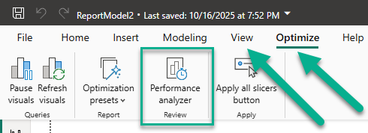
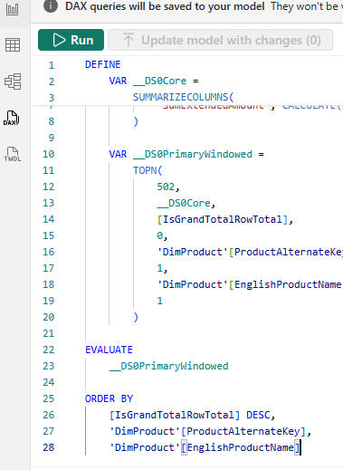
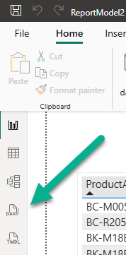
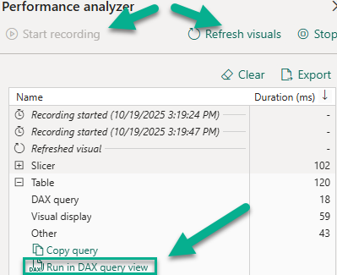
Prepare the DAX queries
Use the DAX Query View

Slide 12
Set up the PowerShell functions
Load cmdlets used
Invoke-DAXQuery.ps1
New-DAXQueryMetaData.ps1
Add-DAXQueryMetaData.ps1
Get-DAXQueryMetaData.ps1
Compare-DAXQuery.ps1
Compare-DAXQueryDataTable.ps1

Slide 13
Find the connection information
Power BI Desktop model is in a Windows Service
Script GetPBIPort.ps1 gets the port number
Variables
Set the path where you put the scripts
Set the Server (localhost:<portnumber>)
Try to determine which port goes to which server
I added a table with version information

Slide 14
Identify the keys and filters
Results have different keys based on filters
IsGrandTotalRowTotal is true: no keys
IsDM1Total: one column key, etc.
TestGetMetadata.ps1
Makes first guess at keys and filters
Writes to a second file
Edit to identify different combinations

Slide 15
Run a test comparison on one file

Slide 16
Comparing files

Slide 17
Running a test
Create a loop through each file

Slide 18
Reading results
Number of rows/columns in each set
Columns with mismatches
Missing rows

Slide 19
Exporting data

Slide 20
Closing

Slide 21
References
https://learn.microsoft.com/en-us/analysis-services/client-libraries?view=sql-analysis-services-2025&viewFallbackFrom=sql-server-2017
russloski@sqlmovers.com

Slide 22
Contact Info
https://github.com/rloski-public/SSASCompare
rloski@sqlmovers.com

Slide 23
Russ Loski
rloski@sqlmovers.com
https://www.linkedin.com/in/russloski
https://www.sqlmovers.com

